Slide 1
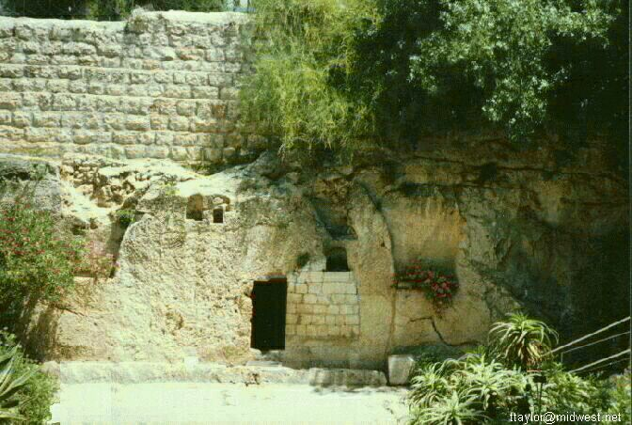
New Life! John 20
Dr. Rick Griffith • Crossroads International Church Singapore
BibleStudyDownloads.org
Notes:
1

Slide 2
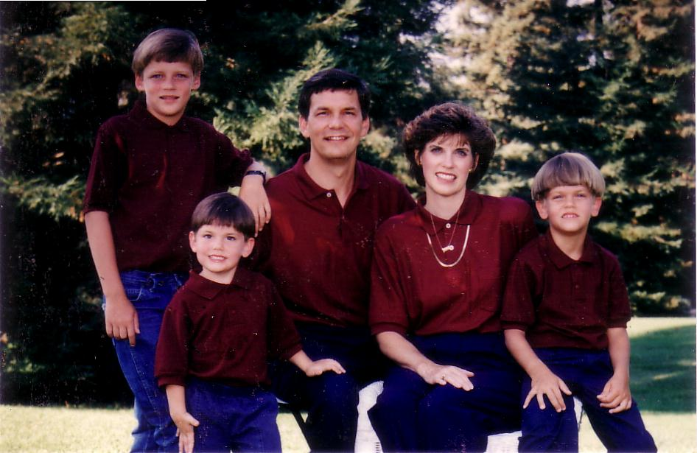
1996
Dad, is Easter a chicken?
Notes:
That’s what John asked me at dinner one Saturday night when he was five years old. I replied, “What made you think that?”
“Well… there’s Easter eggs…”
My boy was thinking—using his reasoning skills. And I, a theologian father, was sinking in my chair! Well, John and I diverted from our evening OT reading for a few nights and did some NT brush up!

Slide 3
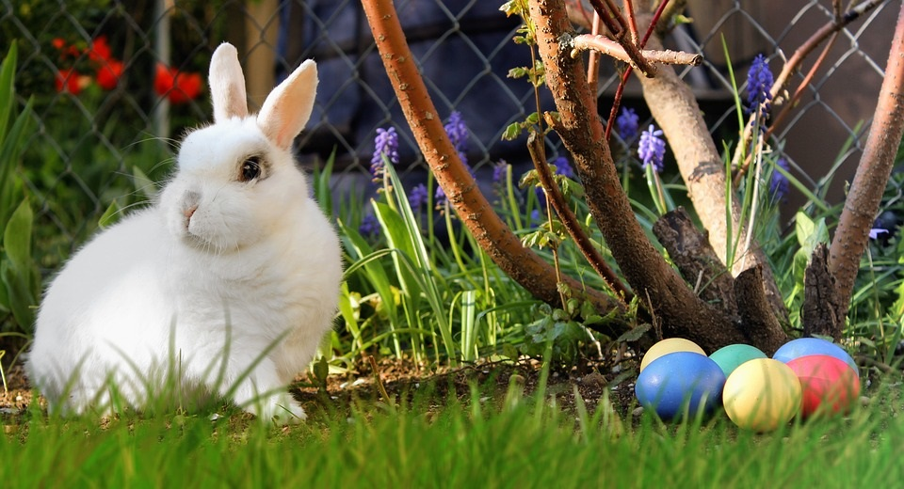
Easter?
Notes:
Need Due to Diversions: This interchange with John caused me to reflect on how many substitutes Satan has created for Easter to get us off the real issue.

Slide 4
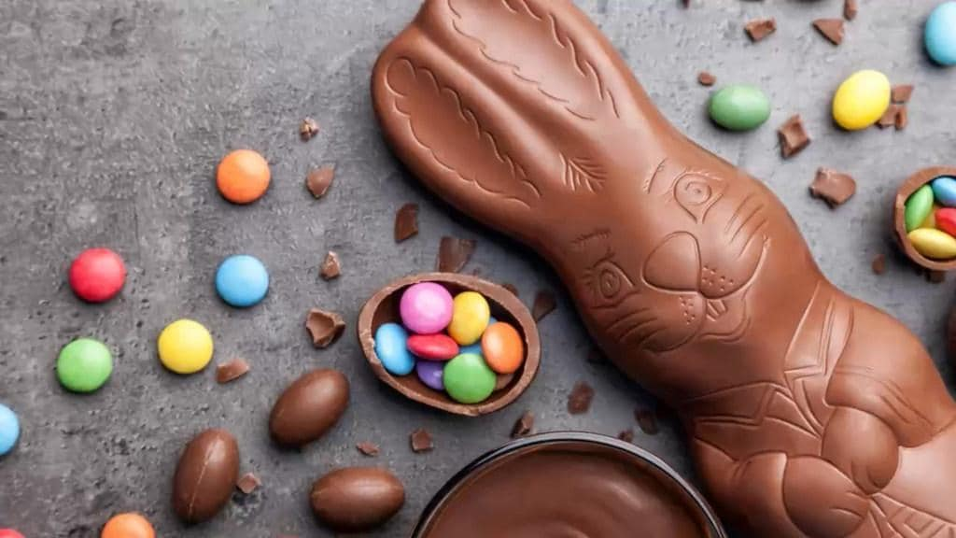
Easter?
Notes:
We focus on eggs, bunnies, and chocolate. They don't even make sense because rabbits don't have eggs!

Slide 5
Easter in View?
Notes:
5
5
Such a focus appeared in a newspaper where a German optician unveiled a new contact lens for Easter: “Easter in View” says the caption. I thought, “Now what does this Playboy bunny have to do with Easter?”

Slide 6
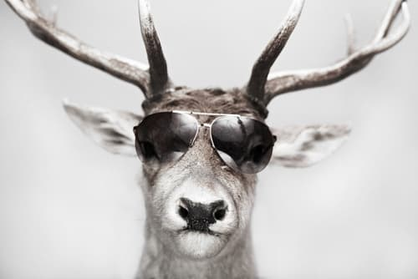
Christmas
Notes:
Satan has made the same replacements to Christmas where, instead of focus on Christ’s birth, we have Santas, reindeer, gifts, obligations and Panadol.
In contrast, the non-Christian religious holidays have no satanic substitutes—Hari Raya is Hari Raya, Vesak Day is Vesak Day, etc.

Slide 7
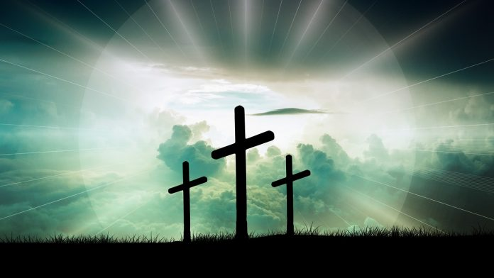
Need
Notes:
Need Due to Doubts: Our enemy know the importance of the cross and resurrection, so many so-called “evidences” against Christ create doubt at this time:

Slide 8
“Christ wasn't God”
Notes:
We all know about The Da Vinci Code that claims Jesus died as a man—not God—saying that his deity was invented 300 years later. Even the claim that Christ was married to Mary Magdalene affects our movie clips, like “The Gospel of John” which depicts Mary Magdalene at the Passover meal when the NT says nothing of the sort.

Slide 9
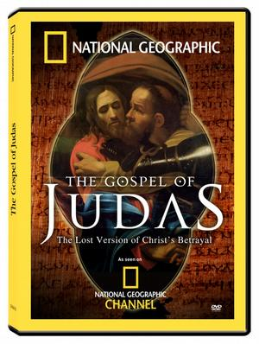
Gospel of Judas
Notes:
The Gospel of Judas letter depicts Judas as the hero of the story who had arranged with Christ this plot to put Christ on the cross.

Slide 10
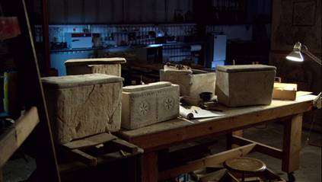
The “Lost Tomb of Jesus”?
Notes:
In 2007 the ossuary or bone box of Jesus was supposedly discovered as “The Tomb of Jesus.”

Slide 11
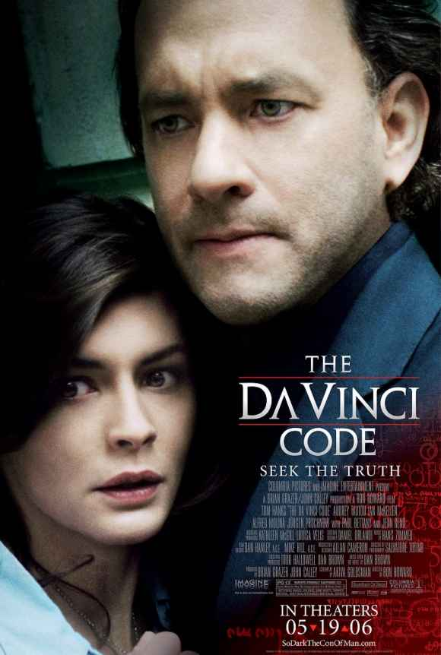
Timing is Critical
March 03
April 06
May 06
March 07
Notes:
But did you notice what month all these doubting mechanisms came out?
• The Da Vinci Code book: March 2003
• The Da Vinci Code movie: May 2006
• The Gospel of Judas: April 2006
• The Tomb of Jesus: March 2007

Slide 12
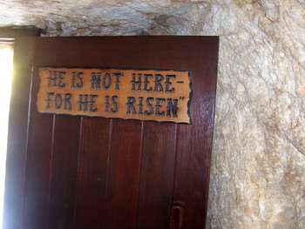
We live because He lives!
Notes:
Isn’t the timing a little too obvious? Each release was carefully designed to happen right around Easter each year! Expect another one this year too. When have you ever seen a so-called evidence campaign against Buddha, Mohammed, Hinduism, or any other religion near their holidays?
But what would our church be without a living Savior?

Slide 13
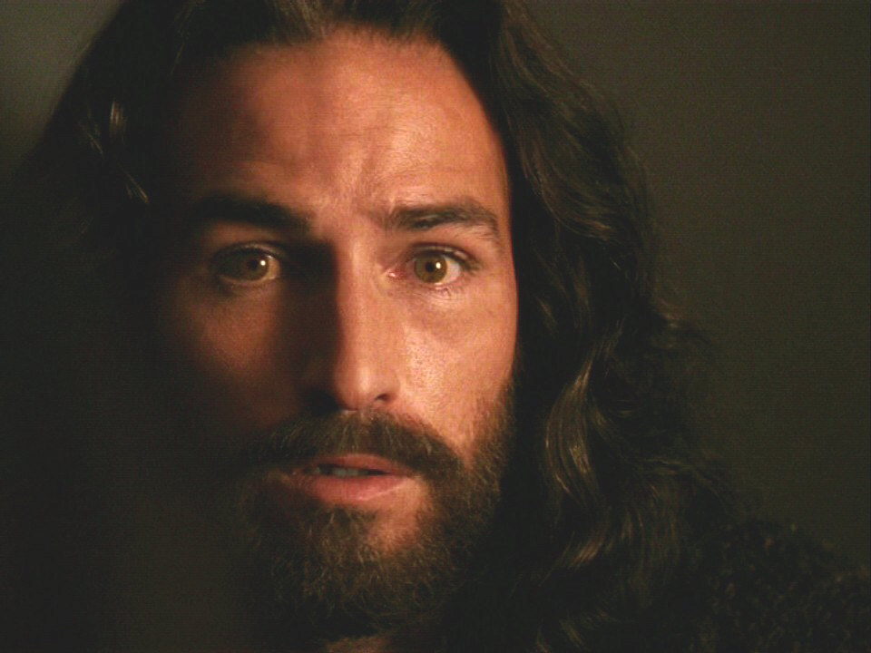
The Resurrection of Jesus Christ
John 20
Notes:
Subject: So we’ve gathered here together today to consider what Christ’s resurrection means—and the answer, of course, is victory over death. We may have our struggles, but our most difficult struggle is with death.
Some time ago Susan and I were listening to a radio announcer reporting on the death rate. I can't recall if he said the rate was going up or down. But with a puzzled look on her face, Susan said, "I thought the death rate was still 100%!" It's true.
This struggle is so hard that everyone fails. All people die. Death has the whole world in its grasp—except One!
Today we celebrate the fact that Jesus Christ has won the victory in the most difficult struggle of all—He has defeated death itself!
Jesus had died and it looked like the Jewish leaders had put Him away once and for all, but Jesus emerged the victor!

Slide 14
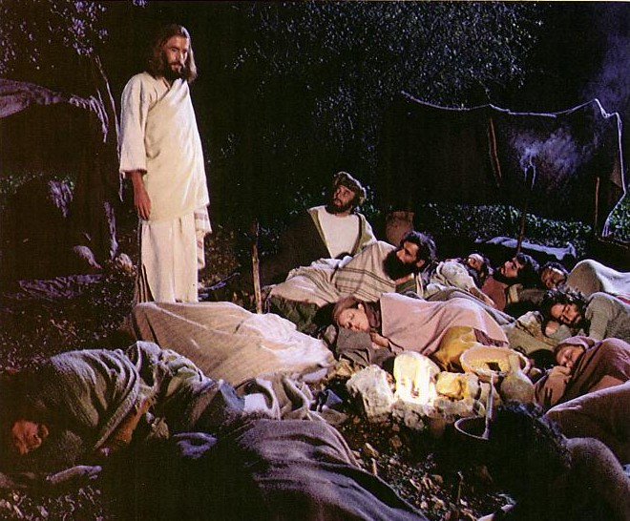
Jesus controlled His own arrest (John 18:1-11).
Notes:
In fact, he controlled his own arrest.

Slide 15
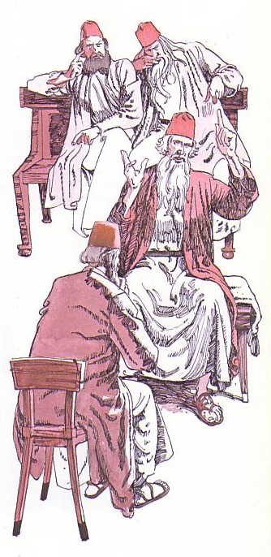
Jesus' illegal trials proved Him innocent (John 18:12-19:16a).

Slide 16
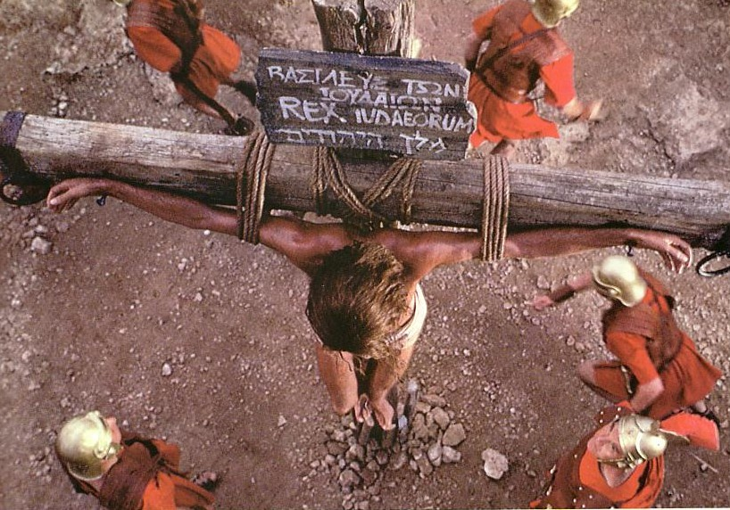
Jesus' death paid for our sin (John 19:16b-42)

Slide 17
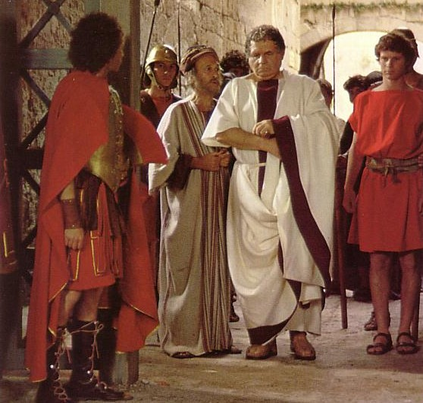
“Make the tomb secure!”

Slide 18
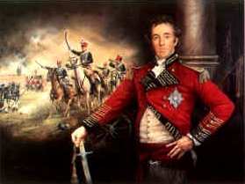
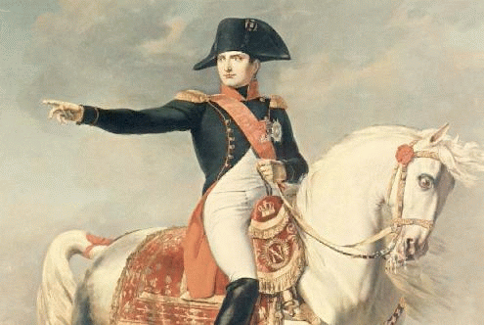
Battle News
Wellington defeated
Napoleon at Waterloo
Jesus defeated
Satan at Calvary
Notes:
18
18
Years ago Napoleon’s forces seemed unstoppable as he rampaged through Europe. The British General Wellington was sent to stop Napoleon’s advance into England.
• As the British waited with anticipation on the outcome of the battle, the message came back, “Wellington defeated…” and then the fog set in. Later, the fog cleared and the full message was revealed:
• “Wellington defeated Napoleon at Waterloo”! What the British people thought was defeat actually was only part of the message.
• And the same is true when people see only Good Friday—death and defeat.
• However, the full message is that “Jesus defeated Satan at Calvary”! [RESURRECTION victory over Calvary].
And this has implications for each one of us!

Slide 19
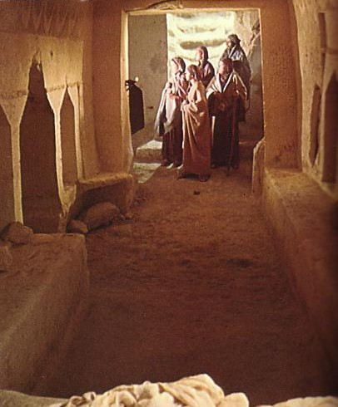
The Key Idea of John 20
Jesus' resurrection meets each of us at our point of need.
Notes:
In your unique situation, you can gain hope and encouragement from the assurance that Christ is alive!
John 20 is our text today.
Preview: This chapter tells us both about the tomb itself as well as what this means to us today.
But how do we know He’s alive? Well…

Slide 20
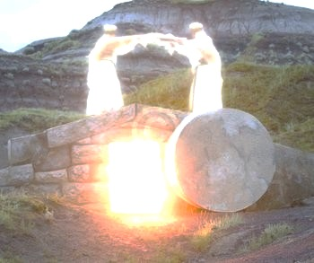
I. The empty tomb shows us that Christ is alive today (20:1-9).
Notes:
The rolled stone and missing body are evidence of His resurrection.

Slide 21
“The Gospel of John” ® Movie
John 20:1-9
Notes:
21
VTS_01_7.VOB at 7:22 for John 19:38
End at 8:57 with "They still did not understand the Scripture that said Jesus must rise from the dead."

Slide 22
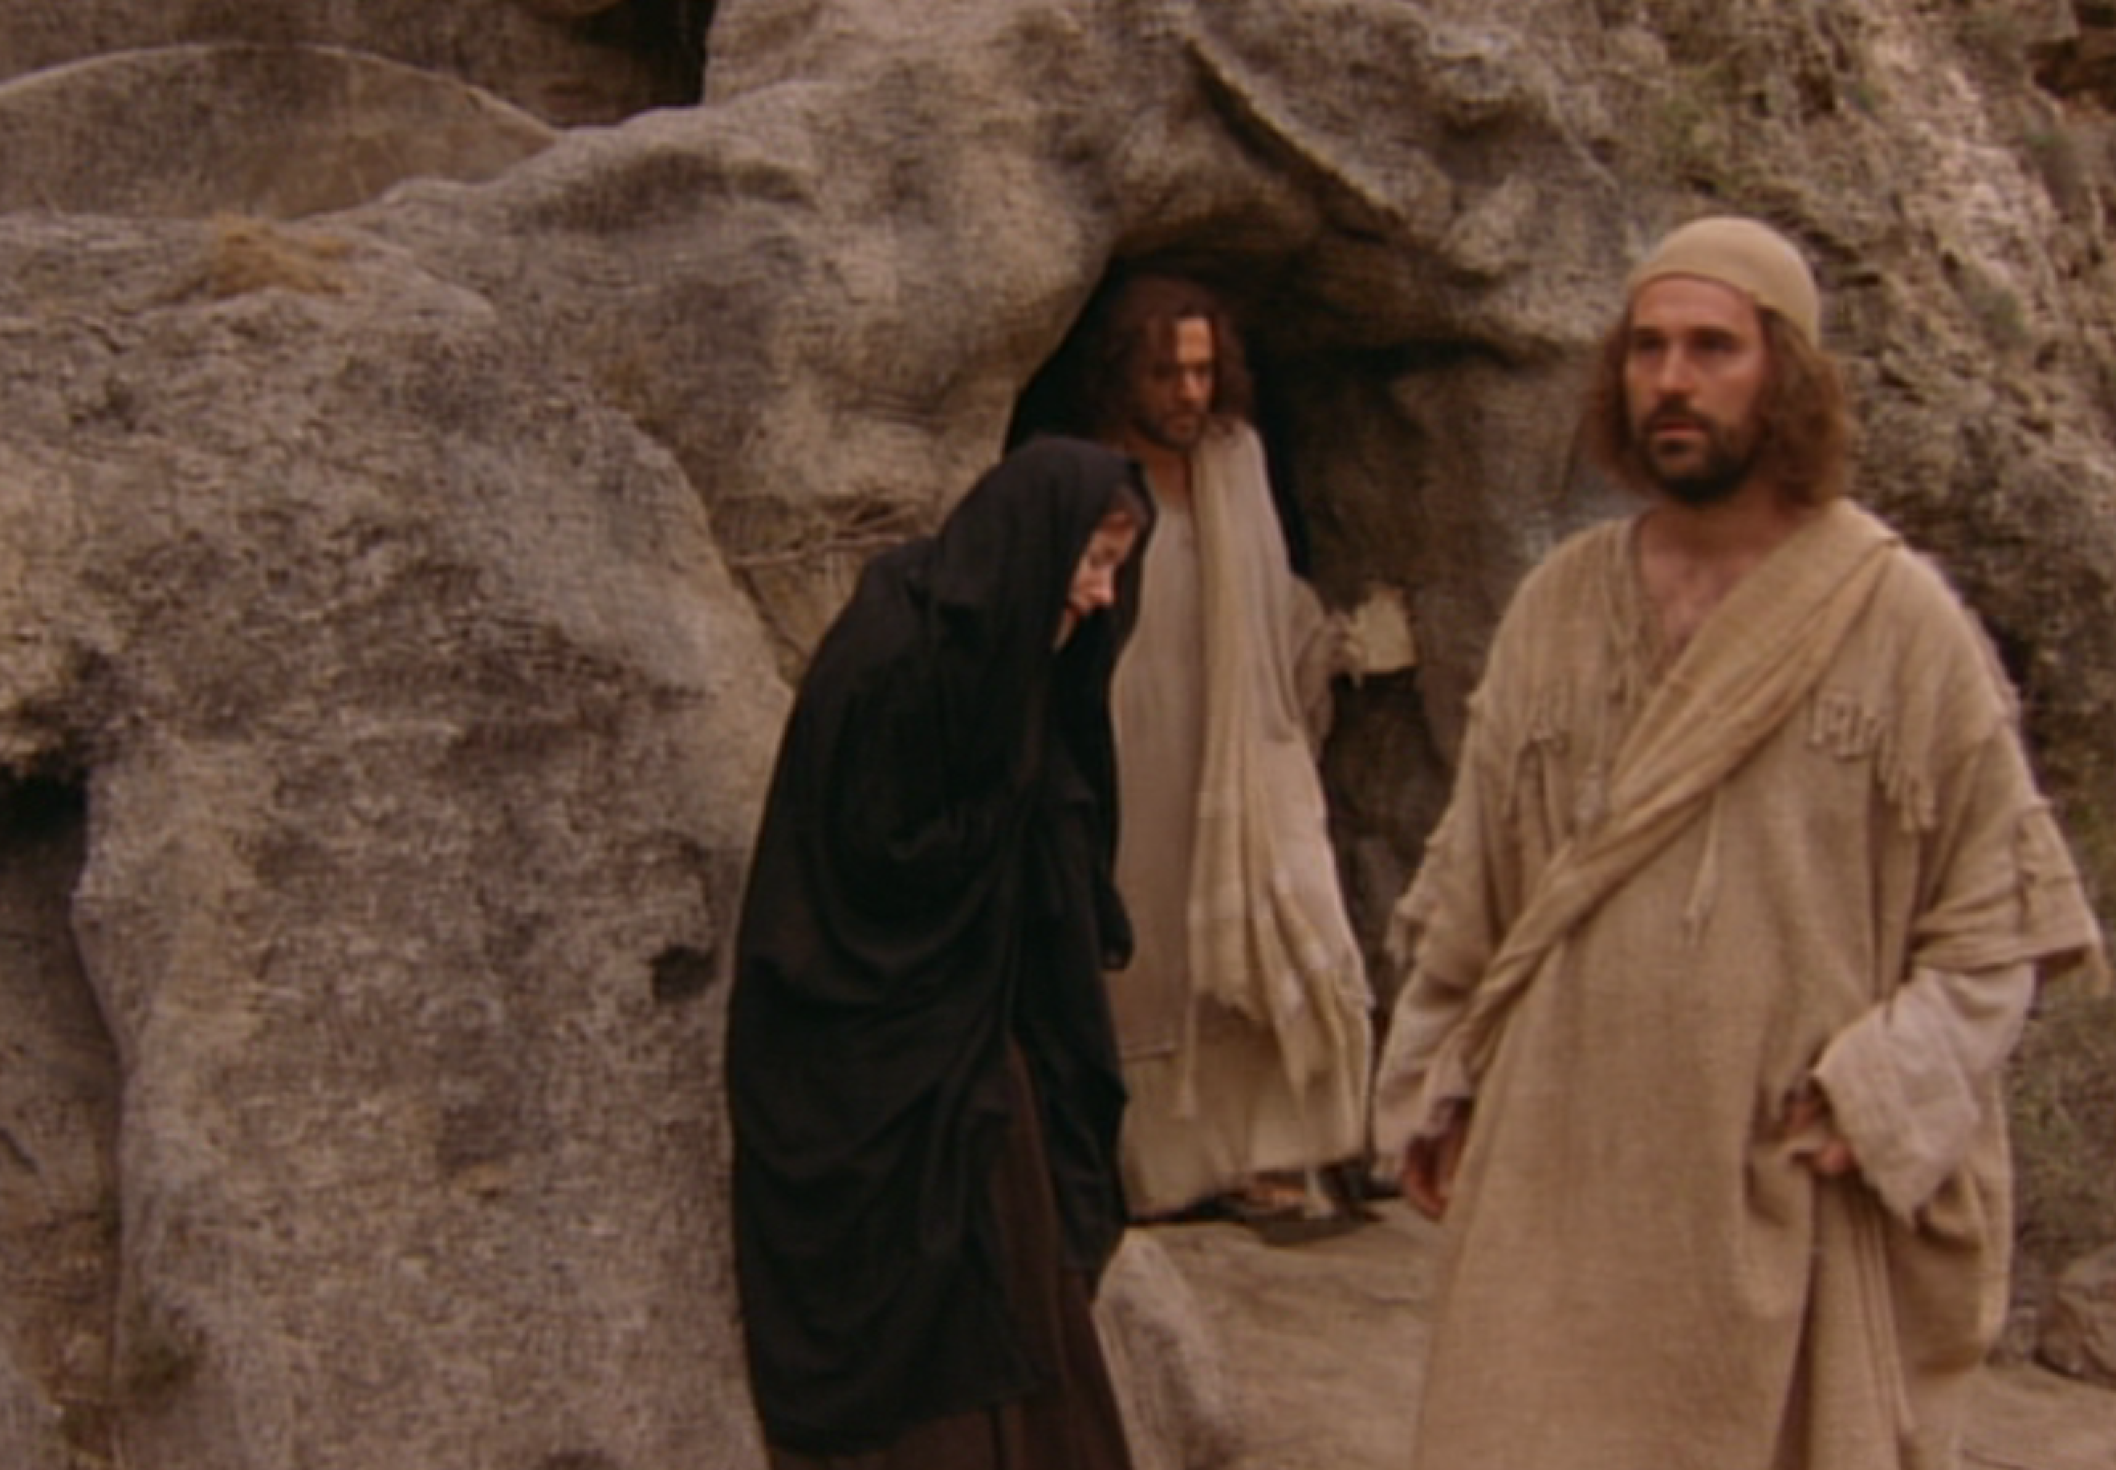
Three Initial Witnesses
Mary (1-2)
John (3-5)
Peter (6-9)
Notes:
In verses 1-9 we see three witnesses of the empty tomb: Mary, John, and Peter.
1. Mary Magdalene (and actually several other women too, not mentioned by John) saw the empty tomb (20:1-2).
Mary was the woman from whom Jesus cast out seven demons. She probably thought, "Now I can show my appreciation for my Lord with these spices."
But by the time she got to the tomb, Matthew records that a huge earthquake split the morning stillness and an angel had moved the stone. Not only had the rocks split, but the guards split too!
She was shocked to see that the 1 1/2 ton stone over the door of the tomb was moved out of the way. Apparently she didn’t enter the tomb but only looked inside and saw that the body was gone.
The first thing she could think of was to tell Peter and John, two of Christ's closest disciples: "The grave robbers have even gotten to our Lord's tomb and stolen His body!"
The other gospels say after Mary left, the other women went inside the tomb and witnessed angels who reported that He had risen—but Mary didn’t know this.
(So Mary and at least 5 other women with her witnessed the empty tomb first…)
2. John was next to see the stone rolled away and the body gone (20:3-5).
Other places in John's gospel reveal "the disciple Jesus loved" to be John.
He was younger than Peter and outran him in the footrace to the sepulcher.
And in his more hesitant manner, John didn’t enter the tomb.
3. Then Peter, in typical impetuous fashion for Peter, boldly rushed into the sepulcher as the third witness that morning (20:6-9).

Slide 23
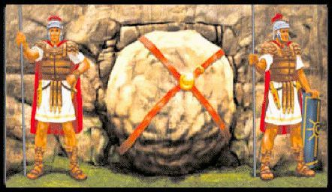
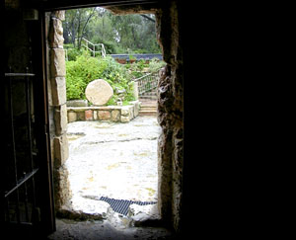
From Inside the Tomb Looking Out
The Roman seal prevented tampering
Notes:
23
23
But what did these witnesses actually see?
• They saw that the Roman seal—a cord stretched over the stone and fastened at either end with wax and stamped with the insignia of the Roman Empire—it was broken.

Slide 24
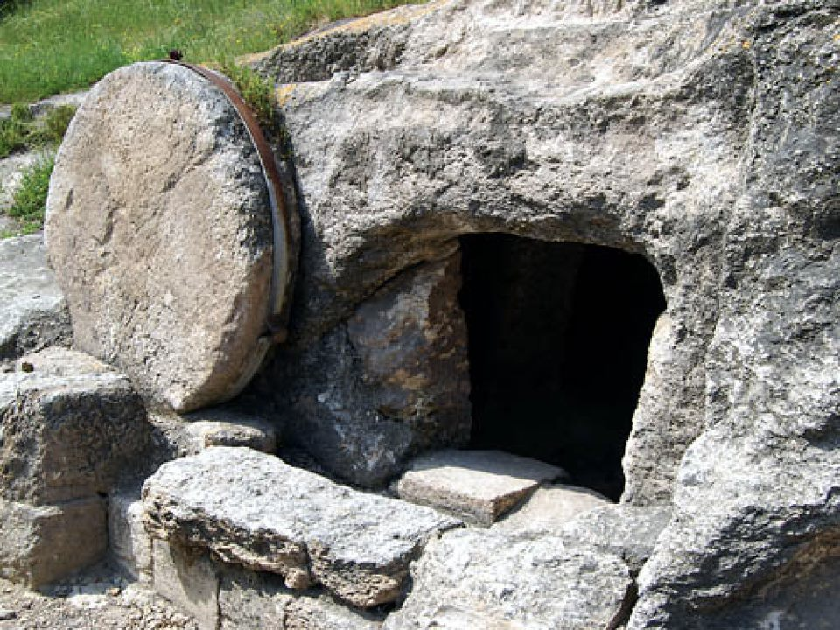
The stone was rolled away…
Notes:
24
24
They saw the huge stone that took 20 men to roll into place was rolled away.

Slide 25
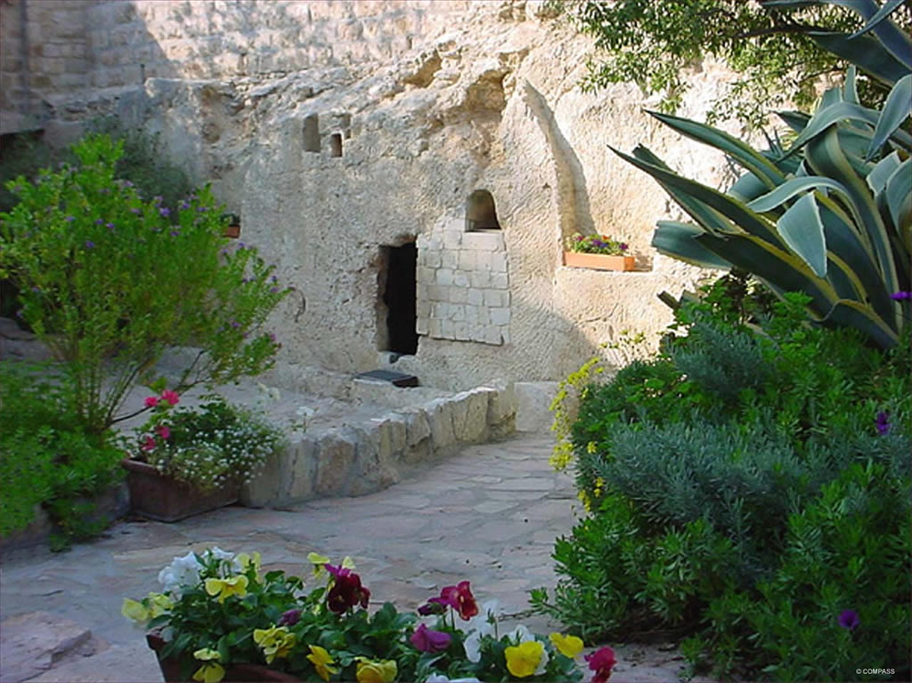
The Garden Tomb
Notes:
25
25
They saw that the guards who had been watching the tomb on penalty of death for any negligence—they were gone too!

Slide 26
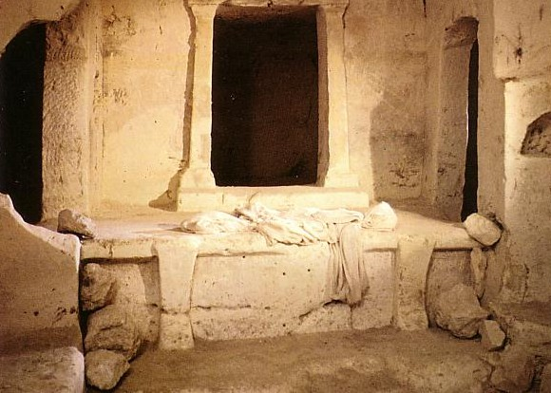
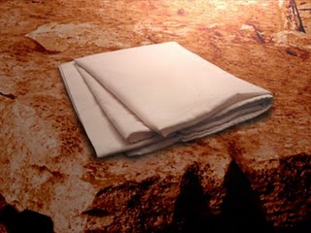
Empty linens
Notes:
Now notice in verses 6-7 what else they saw.
The strips of linen around Christ's body laid where He had been—probably in an empty cocoon shape formed when the body went through them.
• The cloth which had been over His head "was folded up by itself, and separate from the linen." Jesus was a real gentleman who always cleaned up after Himself! I bet He always made His bed!
__________________
Did you catch it? It was just kind of casually mentioned before the text turned to focus on the faith of the disciple who peered into the grave.
What was it?
Consider this: When you’re sitting at the dinner table–assuming you were taught table manners–where is you napkin supposed to rest? On your lap, of course. When the meal is over the napkin is wadded up and tossed onto the plate. This was a sign to the one clearing the dishes (be it a servant of the house…or the womenfolk!) that the meal was over.
If however, the one at the table wanted to leave momentarily and later return to the meal, he would fold his napkin. This signified “I’m not here right now, but I’ll be right back.”
Look again:
Then cometh Simon Peter following him, and went into the sepulchre, and seeth the linen clothes lie, And the napkin, that was about his head, not lying with the linen clothes, but wrapped together in a place by itself.
John 20:6-7
The disciples had received word that the Lord was not in His tomb. Did they assume He rose? Nope. Mary told them that He had been taken and she didn’t know where they had “laid” Him. Mary thought He was still dead. The disciples then ran to the empty tomb. Did they believe? Nope. Not yet at least. It wasn’t until they noticed the napkin…
This napkin was a cloth that covered the face of the deceased as they wrapped the body in the traditional burial fabric. The sight of it left behind in the tomb would not be any cause for an emotional reaction (neither excitement or sorrow), but the sight of it neatly folded and placed on the side: that might spark something.
If Jesus’ body was hastily removed in the middle of the night, it’s not likely the perpetrators would have paused to carefully fold the napkin covering His face.
Furthermore who would have removed His body in the first place? His disciples? How did they get past the guard? How did they get past the giant stone?
Was he moved by the Romans or Jews? If so why the secrecy? Why move Him at all if guards and stones were already in place?
The only logical explanation is Jesus rose from the dead and, being the polite young man His mother raised Him to be, carefully folded His napkin before leaving the tomb? Why?
Because though He was gone…He was coming back!
Matthew Martin
(April 10th) A folded napkin…
http://www.guychurch.com/april-10th-a-folded-napkin/
Accessed 31 March 2018

Slide 27
Seeing is believing?
Notes:
27
27
(We all have heard of the phrase, "Seeing is believing," but is it really true? Does seeing always result in believing? Apparently not because…) Although Peter and John witnessed the same event they had different reactions.
Peter only knew that the body was gone and later that day believed Christ arose when Jesus appeared to Him personally.
But John, verse 8 says, "also went inside. He saw and believed."

Slide 28
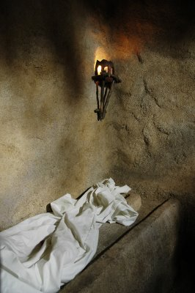
“Seeing” in John 20:5-8
John “looked” v. 5
John “saw” v. 8
“peeped”
“perceived”
Peter “saw” v. 6
“beheld attentively”
Notes:
28
28
In fact, in verses 5-8 there are three different words for "see."
• John "looked" in verse 5, which means "peeped" (Morris, 832 n. 15; cf. “glanced” Moffat).
• In verse 6 Peter "saw," meaning he "beheld attentively" (BKC; cf. “noticed” Moffat).
• But verse 8 records a third word, also translated "saw" in the NIV, but it has the idea that John "perceived." You see, John didn't just see some linens but perceived the significance of the grave clothes and believed.
One writer says, "Peter must have been thinking, 'Why would a grave robber have left the clothes in this order? Why take the [naked] body of Jesus?' But John perceived that the missing body and the position of the grave clothes was not due to a robbery. He realized that Jesus had risen from the dead and had gone through the grave clothes. The tomb was not open to let Jesus out but to let the disciples and the world [in] to see that He rose" (BKC).
Even still, Peter and John didn't understand how Christ's resurrection fulfilled Old Testament prophecy. That's why verse 10 says that they went back to their homes—not to proclaiming the news in the streets!

Slide 29
3 Witnesses
3 Appearances
Notes:
29
29
(We've seen in verses 1-9 that Christ is alive because He left us an empty tomb. The rolled stone and missing body give evidence to His resurrection. But you know, an empty tomb in itself is not proof that Christ rose from the dead.
We've seen that there were three witnesses at the tomb itself.
• Now in John 20:10-29 we will see John record three appearances of Christ away from the tomb.
Each one of these three appearances encouraged different people with differing needs, just as we all have unique needs. As we look briefly at verses 10-29 I think we'll see that…)

Slide 30
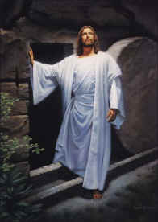
II. Christ's resurrection meets you at your need (20:10-29)
Comforts the despairing Mary (10-18)
Notes:
30
30
Knowing that Jesus is alive will encourage us just where we need faith.
These various people (Mary, the disciples, and Thomas) were despairing, discouraged and doubting. In each situation Christ’s resurrection encouraged them.
• First, Christ's resurrection comforts the despairing [Mary] (20:10-18).

Slide 31
“The Gospel of John” ® Movie
John 20:10-18
Notes:
31
VTS_01_7.VOB at 8:57 for John 20:10
End at 10:01 with Mary "related what He had told her."

Slide 32
Mary needed comfort
Notes:
32
32
What was Mary's problem? She was seeking comfort in her grief—but at least she was seeking and taking initiative.
She probably came back to the tomb because of her grief that her Lord would not have a proper burial, which was very important to Jews.
Notice her answer to whom she thought was the gardener in verse 15b. "Sir, if you have carried him away, tell me where you have put him, and I will get him."
She wants the body to give it a proper burial, without even thinking about the fact that she wasn't strong enough to take the body anywhere by herself anyway.
This is typical of a very grief-stricken person who doesn't make allowances or go into full explanations.
Mary needed comfort.
And Christ met her right in her need.
How? He said her name. There's something comforting about hearing your name, especially when you're despairing. That's why we should make it such a priority to be good at learning names.
When Jesus said, "Mary," there was no question as to His identity.
His resurrection comforted her to the point where she could go and comfort others, which she immediately did (verse 18).

Slide 33
We need comfort too.
Notes:
Perhaps God's message to you today about the resurrection is because you, too, like Mary, are despairing and need comfort.
Your marriage is struggling, your kids are turning away from what you value most, your financial situation is desperate, or people have failed you.
The Good Shepherd knows your name, your situation, and your solution.
“He calls His own sheep by name and leads them out…" [John 10:3].
This Shepherd said, "No one takes [My life] from Me, but I lay it down of My own accord. I have authority to lay it down and to take it up again" [10:18a].
Since Christ has taken his own life up again, conquering death itself—our greatest foe—he can comfort you with this same power.
Will you trust Him who defeated death to defeat whatever may be the cause of your own despair today?
(Mary was despairing and Christ's resurrection comforts the despairing even today. But there's a second group of needy people in verses 19-23—His own disciples. Not only does Christ being alive encourage the despairing, but these verses teach us that…)

Slide 34
II. Christ's resurrection meets you at your need (20:10-29)
Comforts the despairing Mary (10-18)
Encourages the discouraged disciples (19-23)
Notes:
34
34

Slide 35
“The Gospel of John” ® Movie
John 20:19-23
Notes:
35
VTS_01_7.VOB at 10:01 for John 20:19
End at 10:41 with "They are not forgiven."

Slide 36
The disciples needed encouragement
Notes:
36
36
These men hit the depths of discouragement.
Imagine you being with Christ for over 3 years.
You've seen Him heal a blind man right before your eyes.
You were there when He raised Lazarus from the dead.
You grew to love Him for His tenderness with little kids, and yet…
You respected Him for standing up for right—like when He cleared the ungodly, money hungry people from the Temple.
You trusted Him, being convinced He was the Messiah.
You planned on ruling the new kingdom with Him.
You see one crowd proclaim, "Hosanna" and then only five days later another crowd cries, "Crucify Him!"
Since you were with Him so much in public—since you almost got arrested with Him—there's no doubt the Jews would recognize you on the streets as a cohort of the "supposed king" executed a few days before.
You're no dummy—you keep the doors locked.

Slide 37
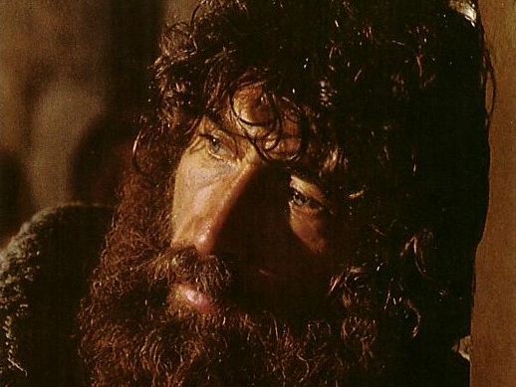
What would it take to turn the despondent Peter around?
Notes:
You've never been more discouraged. You need encouragement.
Then, in the twinkling of an eye, Jesus appears right there in the room before your very eyes!
"Peace be with you," or "Shalom!" He says in the typical Jewish fashion.
You're overjoyed! You want to tell everyone He's alive!
And that's just what He says to do: "As the Father has sent Me, I am sending you" (v. 21).
Sending us to do what? To announce heaven's terms on how a person can receive forgiveness.
"If one believes in Jesus, then a Christian has the right to announce his forgiveness. If a person rejects Jesus' sacrifice, then a Christian can announce that that person is not forgiven" (BKC).
The perfect tense here refers to proclaiming what has already been claimed in heaven (clarified as “have been forgiven” in the NASB).

Slide 38
Discouraged?
Notes:
38
38
But does this relate to us? Could any of us be discouraged like the apostles?
You bet—and discouragement chokes out our potential to help others. When you lose sight of the resurrection, you lose zeal for evangelism. Our knowing that Christ rose from the dead encourages us to witness for Him!
You may feel let down by people like the disciples felt let down by Christ.
Maybe it took all you could muster just to make it here today rather than stay home in front of the computer or TV.
God wants you to take your eyes off circumstances and place them on Christ (gaze-glance principle).
(Unfortunately some still doubt. Some of us here today relate more to despairing Mary, others identify most with the discouraged disciples, but some are more like the doubting Thomas seen in verses 24-29, but…)

Slide 39
II. Christ's resurrection meets you at your need (20:10-29)
Comforts the despairing Mary (10-18)
Encourages the discouraged disciples (19-23)
Gives proof to the doubting Thomas (24-29)
Notes:
39
39

Slide 40
“The Gospel of John” ® Movie
John 20:24-29
Notes:
40
VTS_01_7.VOB at 10:41 for John 20:24
End at 11:37 with "How happy are those who believe without seeing me."

Slide 41
Thomas needed proof.
Notes:
41
41

Slide 42
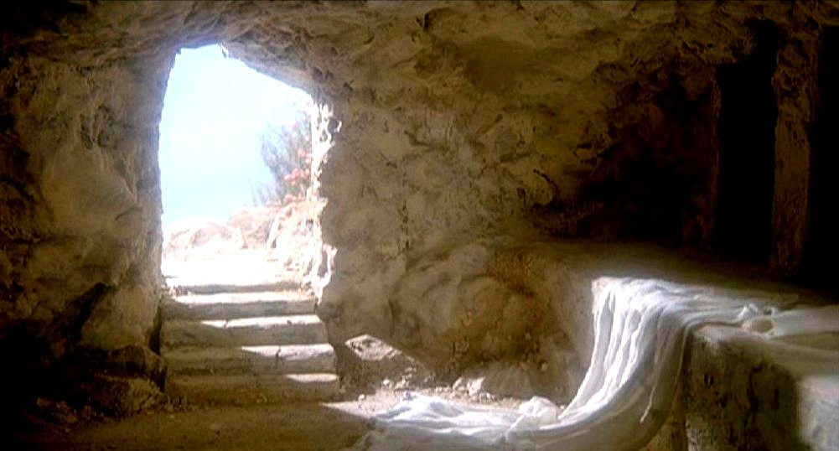
Need proof?
Notes:
42
42
Maybe you have doubts about Christ's resurrection like Thomas did.
Perhaps you don't feel that the evidence is as overwhelming as I see it.
All this means is that you need to do more study! Only those ignorant of history disbelieve the resurrection of Christ.
I’d be glad to talk to you more individually and evaluate the facts with you.
But Jesus typically doesn’t make house calls today. That’s why He says in verse 29 that believers who have not seen are even more blessed.

Slide 43
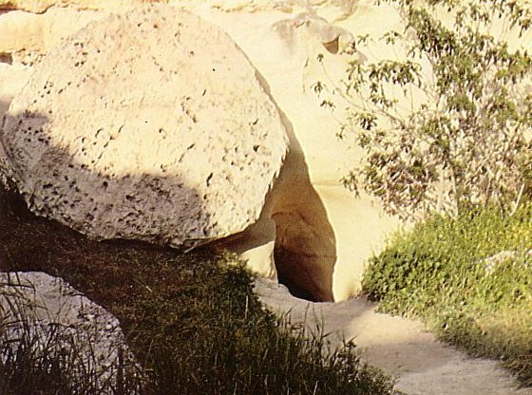
Who moved the stone?
He never died?
Jesus' strength?
Romans?
Jewish Leaders?
Disciples?
Notes:
Just look at the evidence and ask who moved the stone? Some say Christ never died—he just fought his way out! The Romans wouldn’t have moved the stone on fear of death, the Jewish leaders did all they could to prevent it, the disciples were so despondent that they certainly couldn’t have fought off an entire Roman guard to steal a body and die for the lie!
(But believing that Christ rose from the grave is a very necessary part of being a Christian. In fact, we see in verses 30-31 that…)

Slide 44
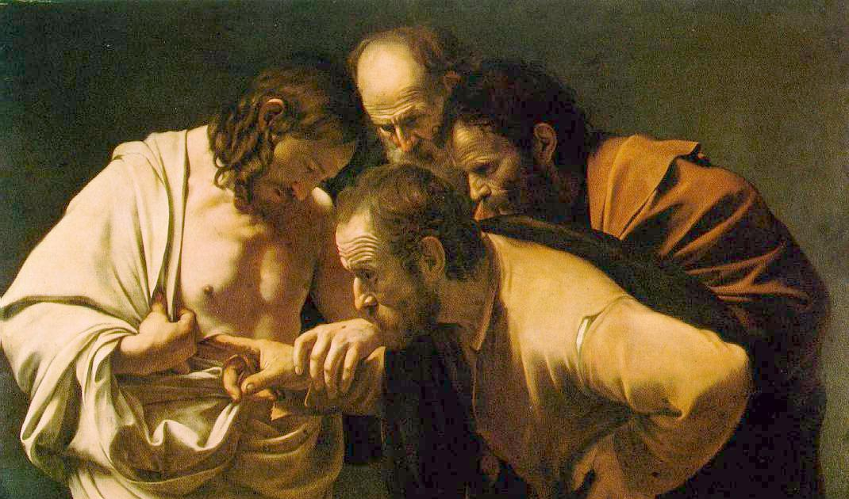
Why did John write about Jesus' miracles?
III. Christ's miracles are to bring us to trust Him (20:30-31)
Notes:
The purpose Jesus did miraculous signs was to help us believe.

Slide 45
“The Gospel of John” ® Movie
John 20:30-31
Notes:
45
VTS_01_7.VOB at 11:37 for John 20:30
End at 11:50 with "You might have life."

Slide 46
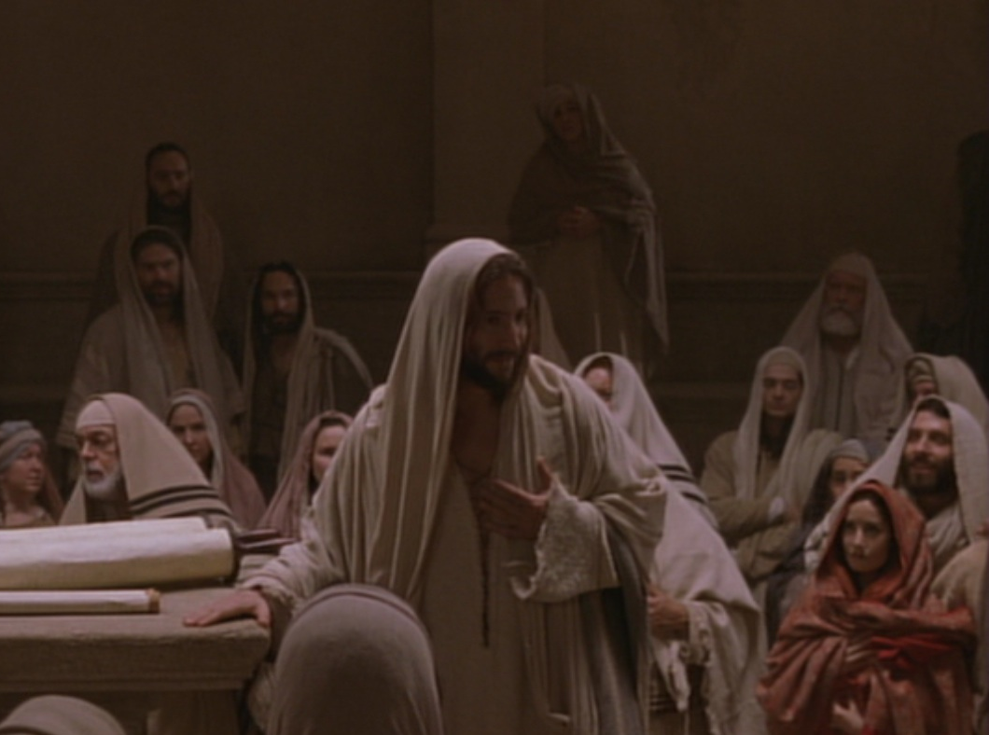
Key Word Believe
John
107
Key Verse
“Jesus did many other miraculous signs in the presence of his disciples, which are not recorded in this book. But these are written that you may believe that Jesus is the Christ, the Son of God, and that by believing you may have life in his name” (20:30-31).
Notes:
Christ did many other miracles that the Bible doesn't mention (30).
Obviously the New Testament doesn't tell us everything Jesus ever did.
But it does tell us enough to place our trust in Him.
Throughout his book John gave these signs or miracles to prove Christ's deity (31a).
These miracles are to help us trust Christ for salvation and receive eternal life (31b).
(So how can we wrap up all John is saying to us in chapter 20? Simply this…)

Slide 47
John's Key Idea:
Jesus' resurrection meets each of us at our point of need (John 20).
Notes:
Christ’s resurrection meets you at your point of need—for comfort, encouragement, or proof—whether seeking, discouraged or doubting.

Slide 48
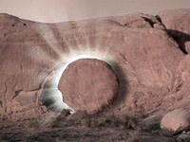
Trust the Living Savior to Meet Your Need Today!
Despair
Comfort
Discouraged
Encouraged
Doubt
Proof
Notes:
48
48
What is your need this morning? Trust the living Savior to meet it! With whom in our story do you relate most?
1. Are you seeking comfort today like Mary? Take comfort that if He has defeated death itself, any other problem for Him is a piece of cake.
2. Maybe you're discouraged like the disciples.
Do you fear what may happen to you if you really commit to Christ?
John G. Paton committed himself to share Christ with a cannibalistic tribe of savages. Some friends could hardly believe he was doing this and tried to convince him not to go, saying, “You’ll be eaten by cannibals!” His response? “God has led you here to stay and die in this country and eventually be eaten by worms. But for me, it doesn’t matter to me whether I am eaten by cannibals or worms!”
3. Christ getting a new body means we also will get a new body. This helps us put life in its true perspective. Don’t let anyone or anything discourage you from pursuing his calling for your life.
Perhaps you have some doubts as Thomas did.
Remember the issue isn't "seeing is believing."
Many in Christ's day saw all kinds of miracles but still rejected him.

Slide 49
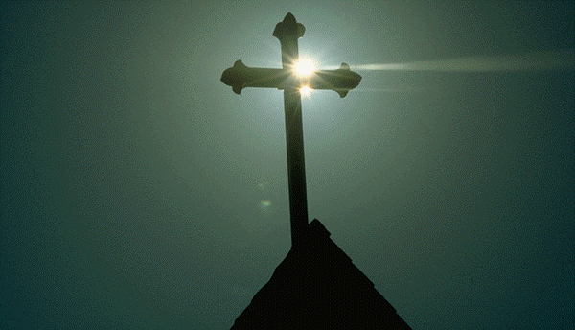
What's So Good About Good Friday?
Jesus controlled His own arrest
Jesus' illegal trials proved Him innocent
Jesus' death paid for our sin
Jesus' resurrection proved He gives eternal life

Slide 50
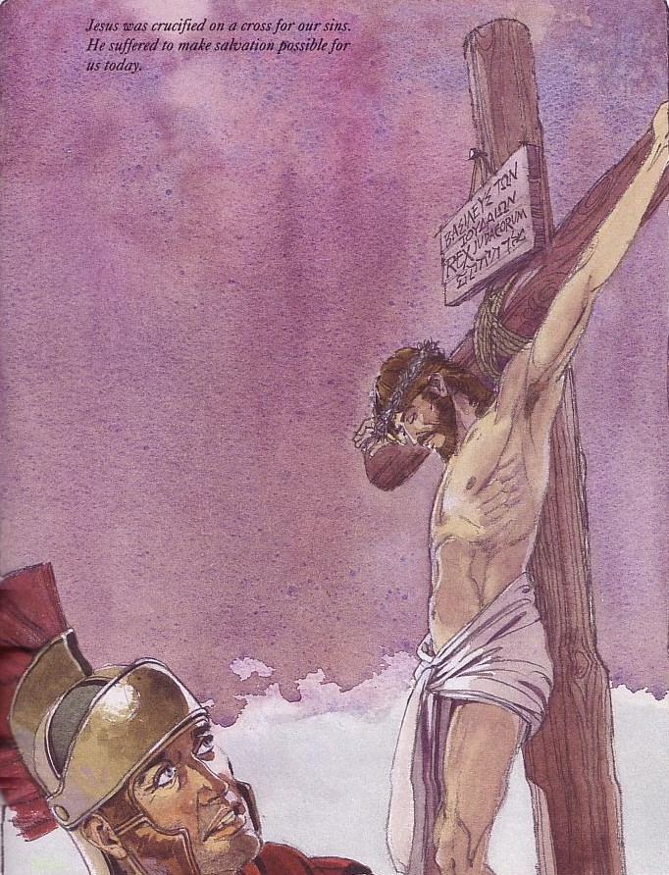
Good Friday is good because on this day Jesus Christ paid for your sin.

Slide 51
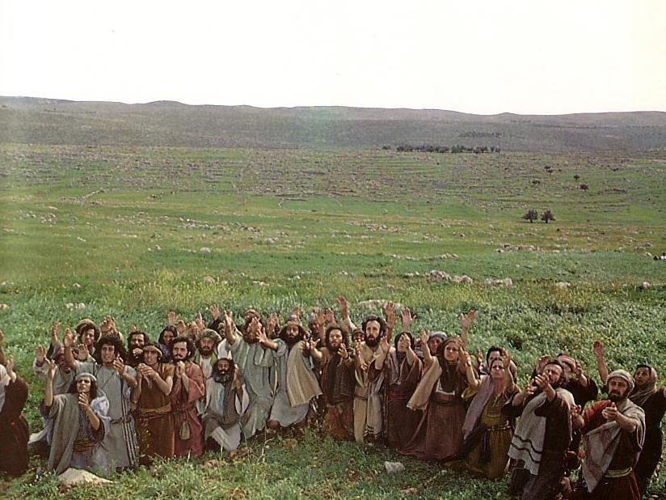
Jesus ascended to the Father
This means he is alive now!

Slide 52
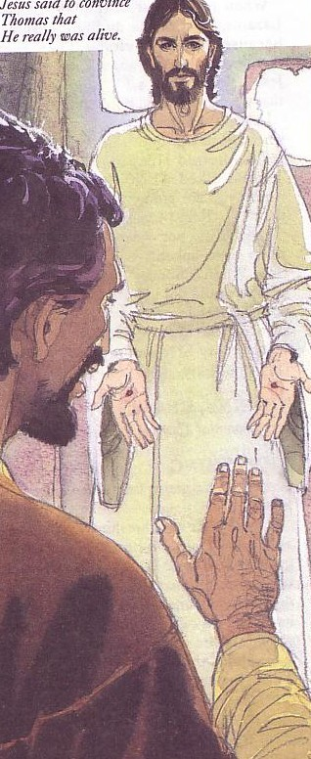
Jesus rose to give you new life!
Jesus rose to give you new life!

Slide 53
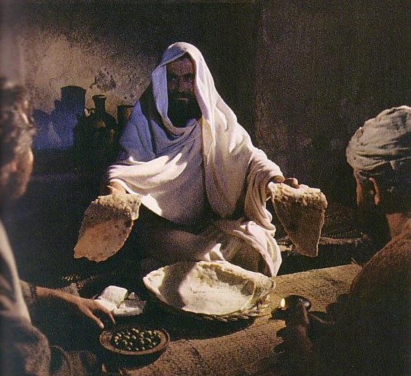
How can you know Him?
Admit you have sinned
Believe that Jesus died for you
Confess that Jesus is God made man
Notes:
Yet if you feel some legitimate questions prevent you from trusting Christ, let's talk, OK? I’ll just wait for you right here up front.

Slide 54
Black

Slide 55
NT Sermons link at BibleStudyDownloads.org
Get this presentation and script for free!

